Slide 1
BitByBit
Application Design
Fazlul H Faizal, Moh Prajapati, Joshua Delshad,Fotios Bampouridis, Eitan Abrishami

Slide 2
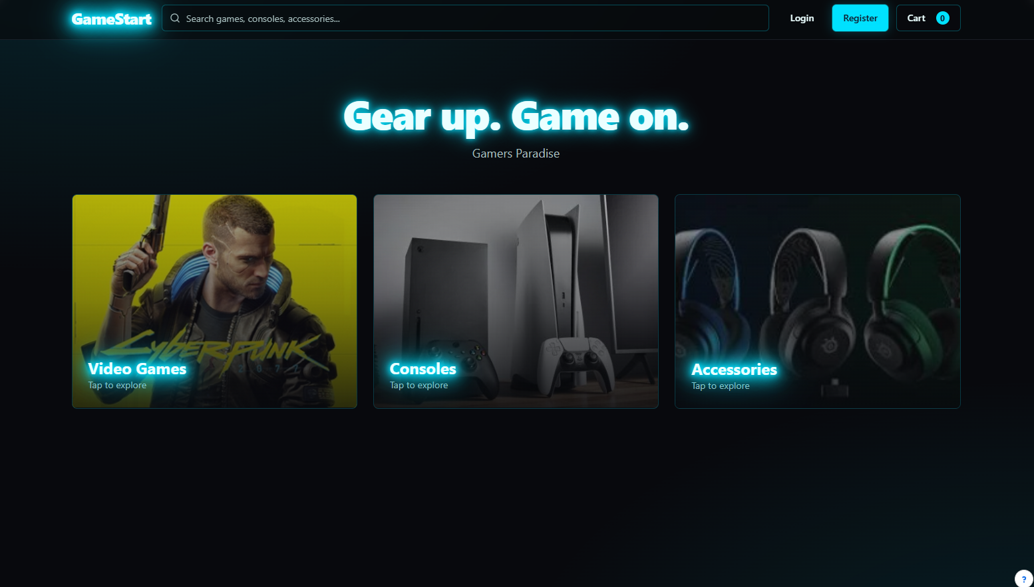
Homepage
This is the homepage. The user can choose to view the list of Video Games, Consoles, and Accessories. When clicking on one of these, it will lead them to the page they chose. If you choose to click the log in or register it will lead to the login/register page.

Slide 3
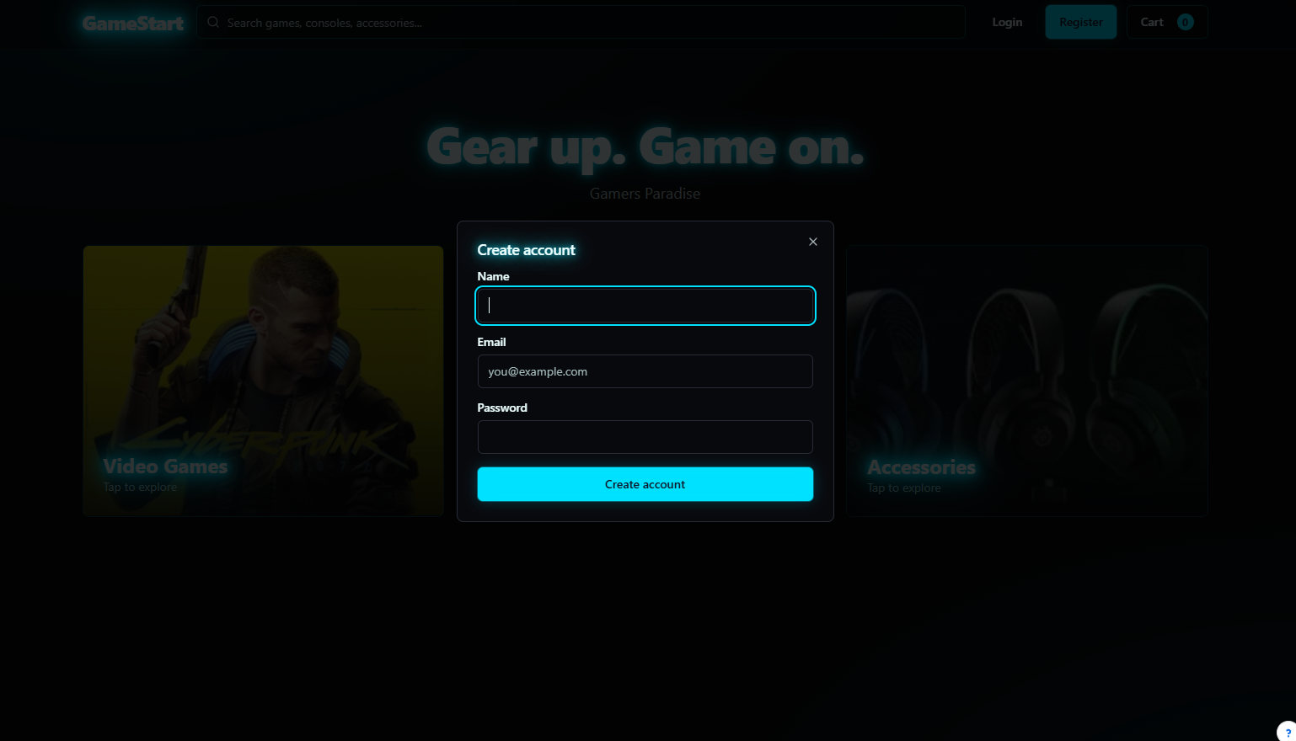
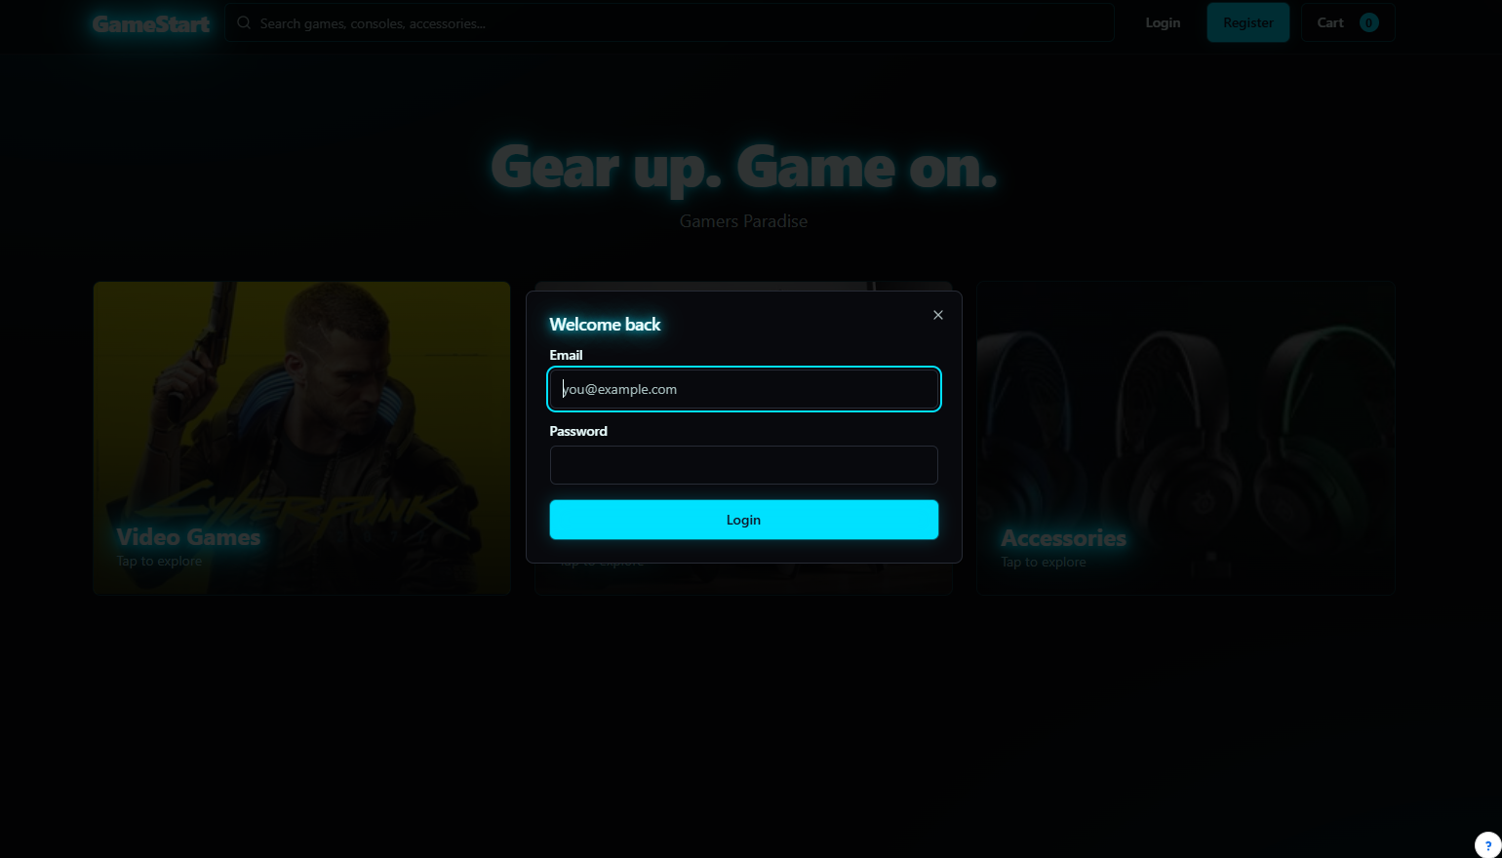
Company Name
Log-In/Registration page
This page allows for two tabs, login/registration.
After logging in or registering, the user is able to checkout and buy a product.
User can also log in before choosing a product or while choosing a product.

Slide 4
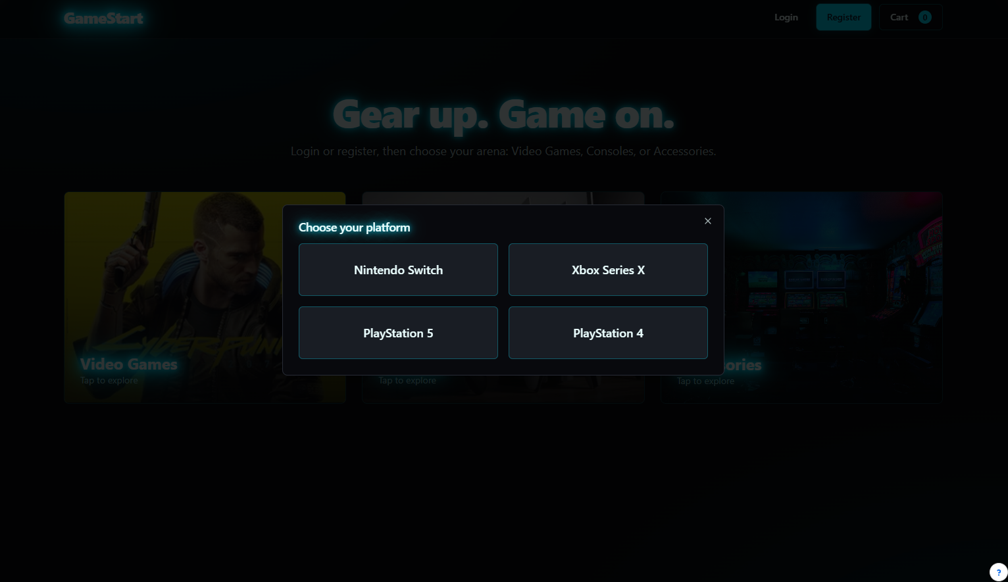
In-App Dialog
After clicking the Videos Games, Consoles, or Accessories page on the homepage, the user will be lead to this page which will allow the user to choose which platform he wants to buy from (Playstation 4, Nintendo Switch etc.). After choosing the platform, the user will go to the respective page with the items matching the chosen platform.

Slide 5
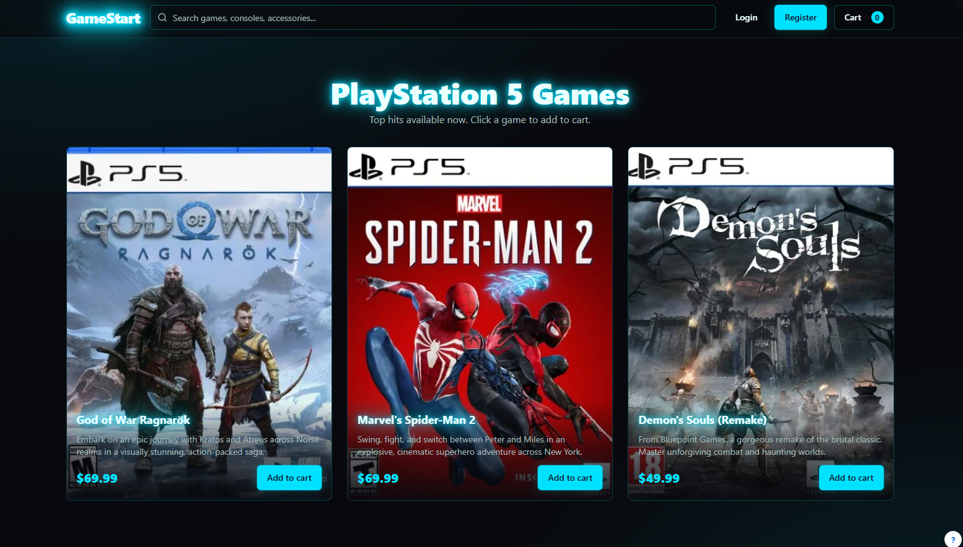
Contents
This page allows you to see and search games you want. You can also search them. It will show you the price and a small description.

Slide 6
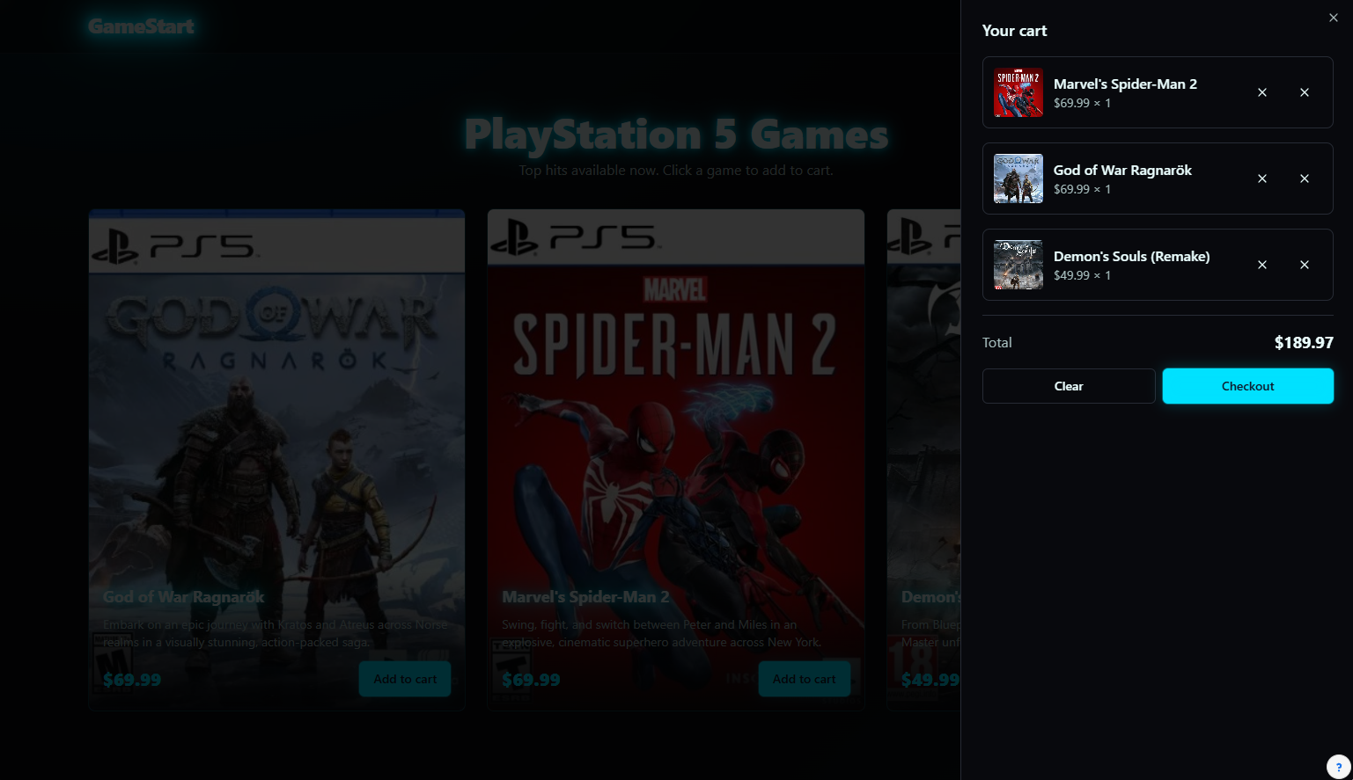
Cart Pop Out
Anytime after you add a game to your cart, the cart popup page come up with what's been added to the cart. The cart has a few options, you proceed to checkout, clear the whole cart, or clear individual products.

Slide 7
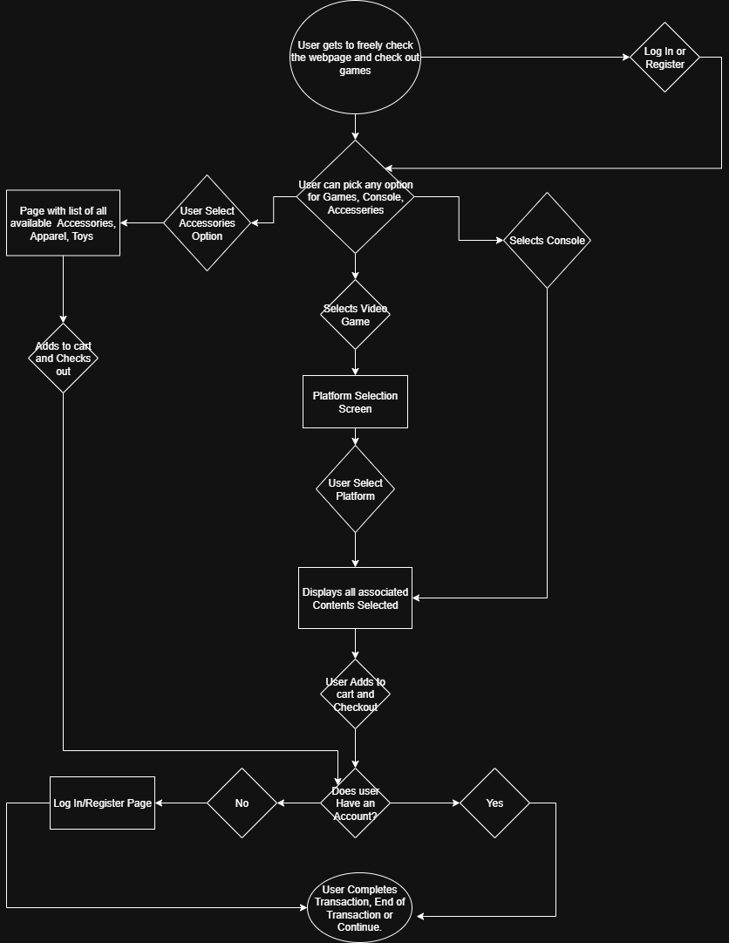
Process Flow
Upon opening the Home page, user gets to freely browse
User can select Games, Console, Accessories
User can select associated content depending on selection

Slide 8
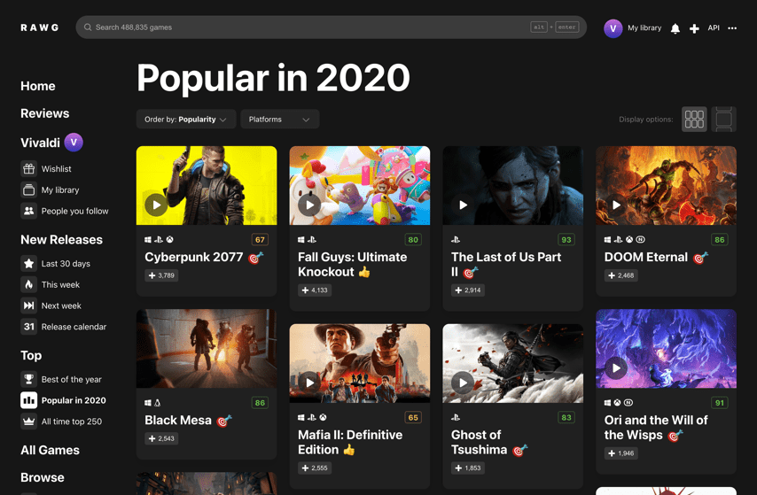
API
RAWG Games Database API
https://rawg.io/apidocs
We are using LangChain to build a smart chat box for users. It will connect the AI to databases and tools to provide accurate answers. The chat box will use the RAWG Games Database API to show live player counts, ratings, labels, and pictures of games for recommendations. It will also remember past conversations and assist users efficiently.

Slide 9
QUESTIONS & COMMENTS

